Slide 1
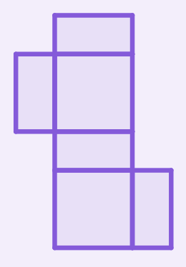
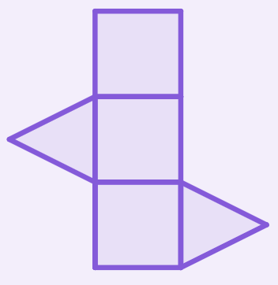
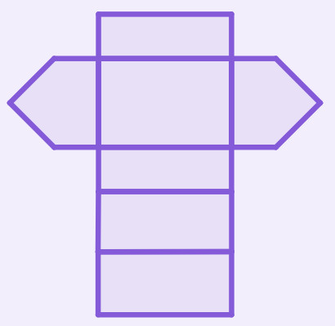
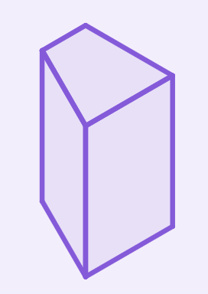

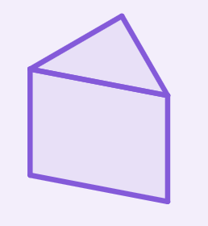

Surface area of prisms
Task A: Nets of right prisms
1) Match the net to its prism. Sketch the missing net and prism.
Task B: Calculating the surface area of prisms
1) a) Complete the description of the faces for this right octagonal prism.
irregular octagons 8
b) Draw all the unique faces of this prism, with dimensions.

Slide 2
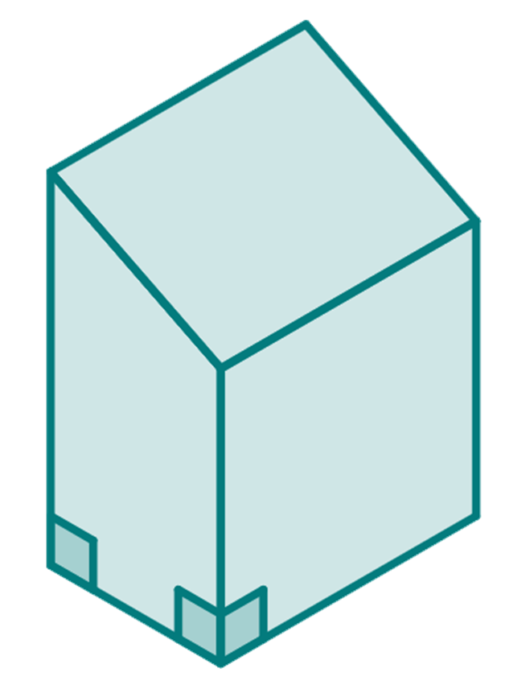
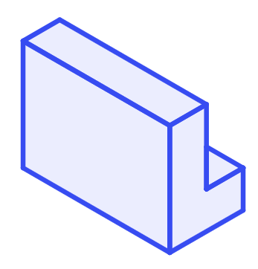


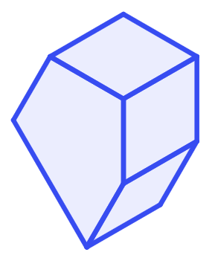
Surface area of prisms
2) Work out the surface area of this right trapezium based prism.
3 cm
2.6 cm
4 cm
3 cm
2 cm
Task C: Being efficient in finding the surface area
Diagrams not drawn to scale
Calculate the surface area of the following right prisms
1)
1 m
12 m
2)
6 mm
9 mm
3 m
12 mm
1 m
2 m
3 mm
9 mm
3)
10 cm
4)
2 m
4 cm
12 cm
2 m
2 m
45 m²
13
cm
4 m
2.5 m
2 m
Mathematics in Education and Industry.
v2.2

